Slide 1

FLYMAN
PVC DOOR WİNDOW & INSECT SCREEN ACCESSORIES

Slide 2
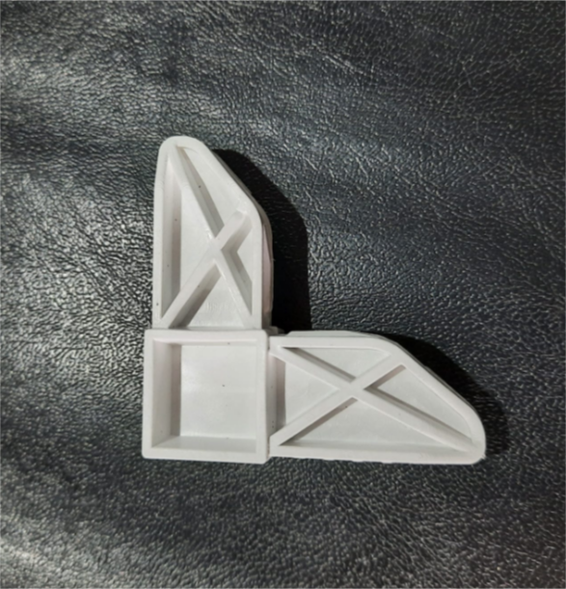
INSECTSCREEN CORNER HEDGE F-16
- 17 X 25 CORNER WEDGE
- FOR 90° CUT PROFİLE
- WHİTE
- RAL 9016

Slide 3
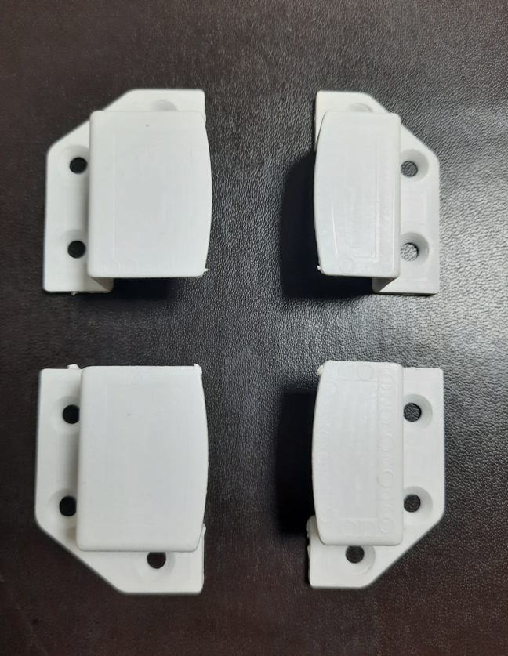
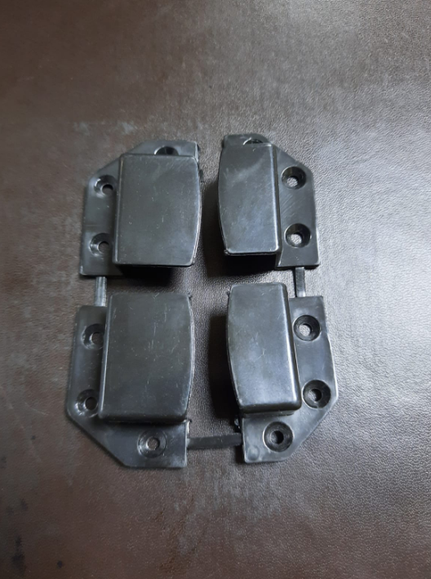
17 X 25 INSECT SCREEN FASTENING PLATE F-17
- 17 X 25 FASTENING PLATES
- 4 PİECE
- RAL 9005 (BLACK)
- RAL 9016 (WHITE)

Slide 4
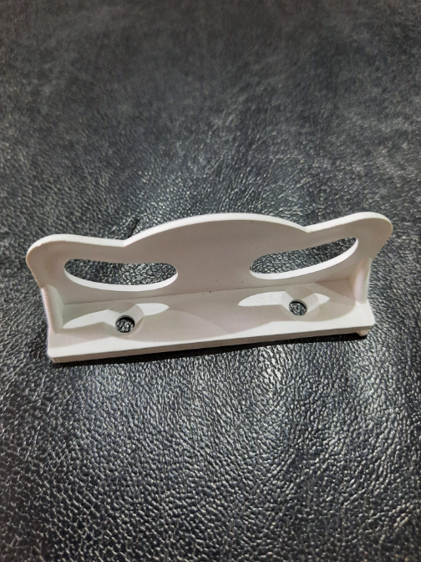
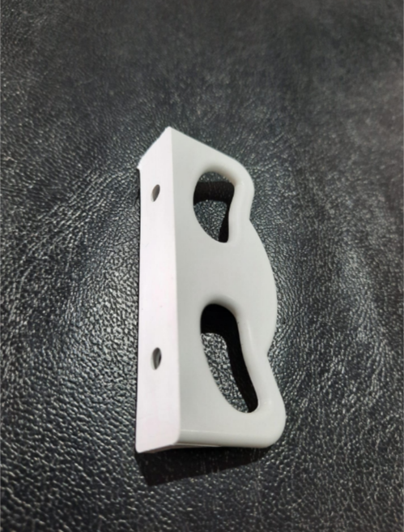
INSECTRSCREEN HANDLE WHITE F-18
- HANDLE FOR SLIDING
AND HINGED SYSTEMS
- WHITE
- RAL 9016

Slide 5
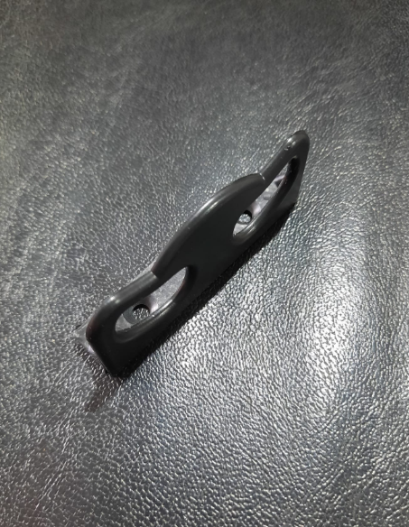
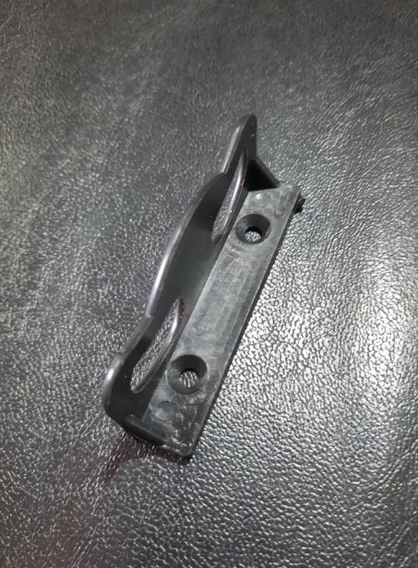
INSECTRSCREEN HANDLE BLACK F-18
- HANDLE FOR SLIDING
AND HINGED SYSTEMS
- BLACK
- RAL 9005

Slide 6
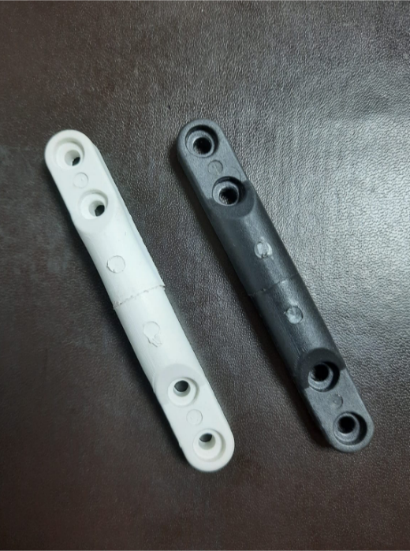
17 X 25 INSECT SCREEN HINGE F-19
BLACK - WHITE
- 17 X 25 HINGE 9.3 cm
- RAL 9005 (BLACK)
- RAL 9016 (WHITE)

Slide 7
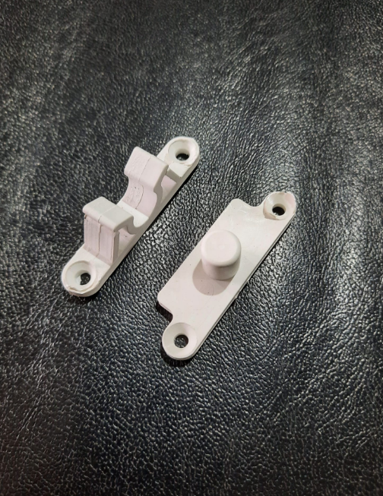
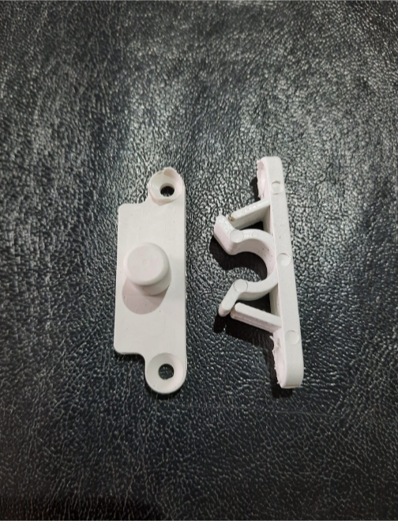
17 X 25 INSECT SCREEN GRIPPER WHITE F-20
- 17 X 25
- GRIPPER
- WHITE
- RAL 9016

Slide 8
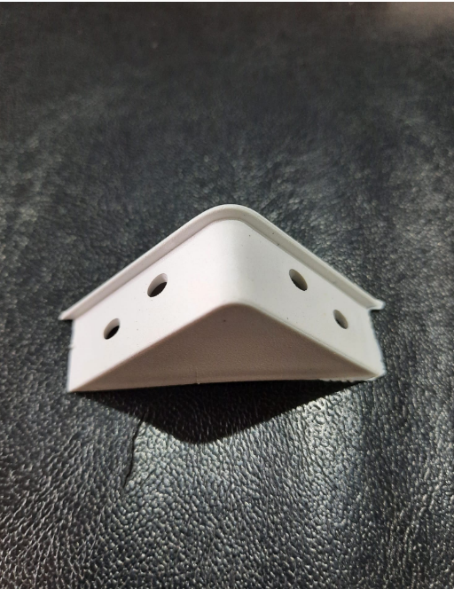
INSECT SCREEN CORNER STRENGTH WEDGE F-21
- 90°STRENGTH WEDGE
- WHITE
- RAL 9016

Slide 9
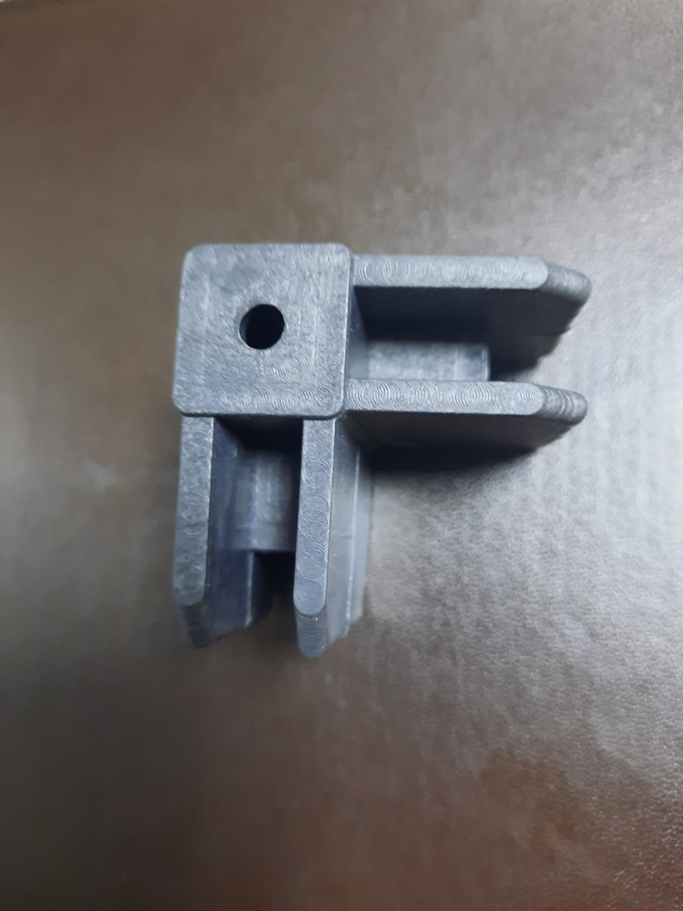
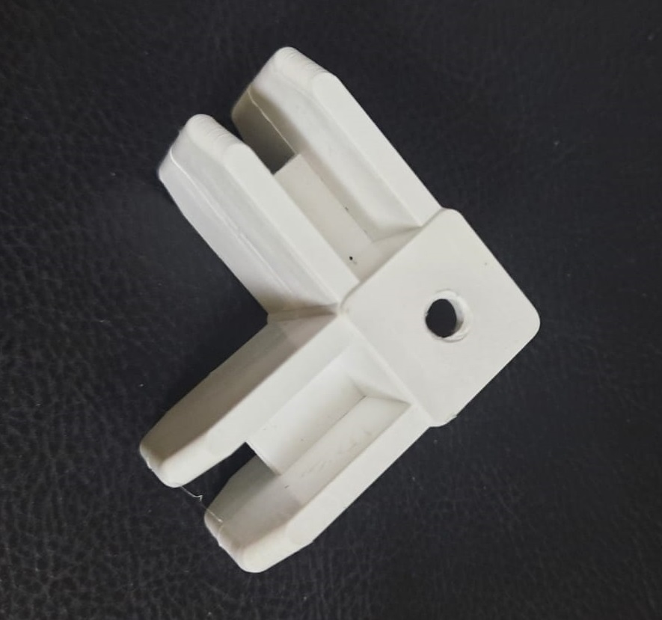
20 X 40 CORNER WEDGE F-22
20 X 40 CORNER WEDGE
FOR 90° CUT PROFILE
- RAL 9005 (BLACK)
- RAL 9016 (WHITE)

Slide 10
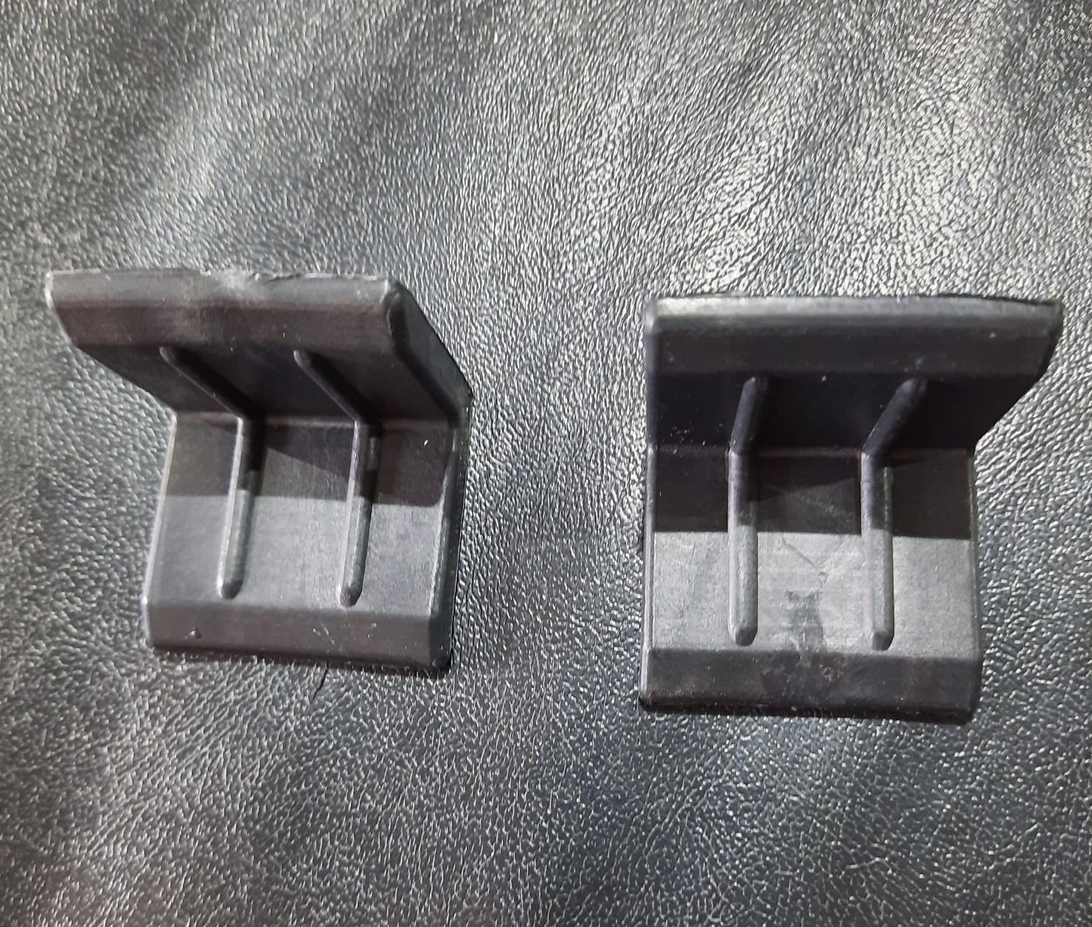
SLIDING SYSTEM WEDGE F-23
- FOR 45° SLIDING SYSTEM
- UNVISIBLE IN FRAME

Slide 11
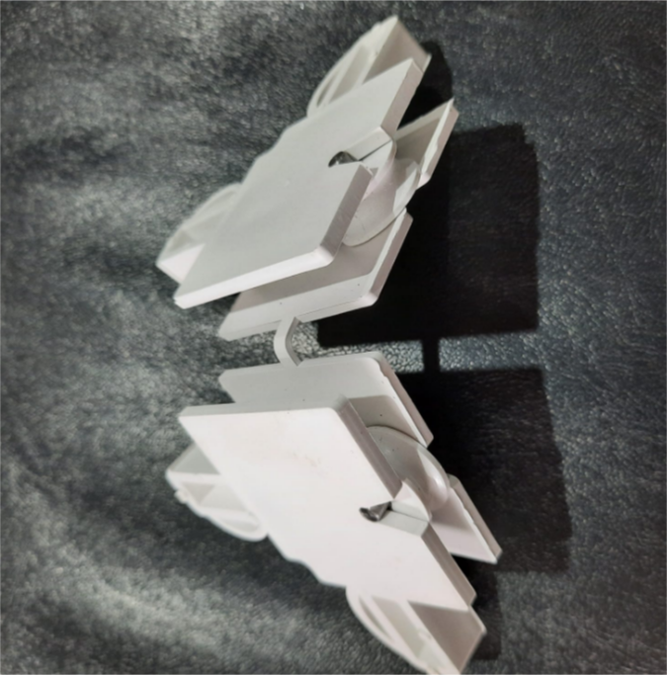
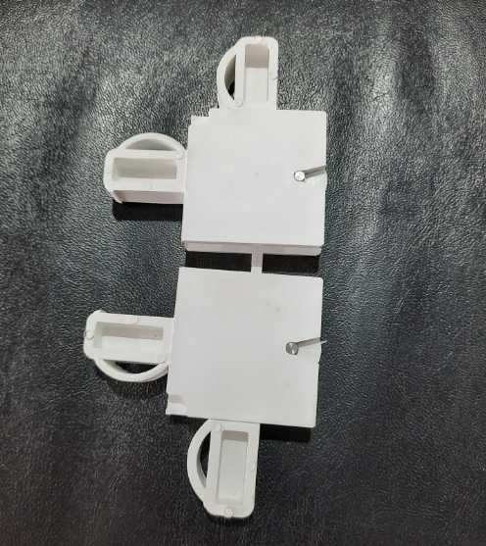
SLIDING INSECT SCREEN CORNER WEDGE F-24
WİTH WHEEL WHITE
- SLIDING SYSTEM
- INCLUDING WHEEL
- FOR 90° CUT PROFILE
- WHITE
- RAL 9016

Slide 12
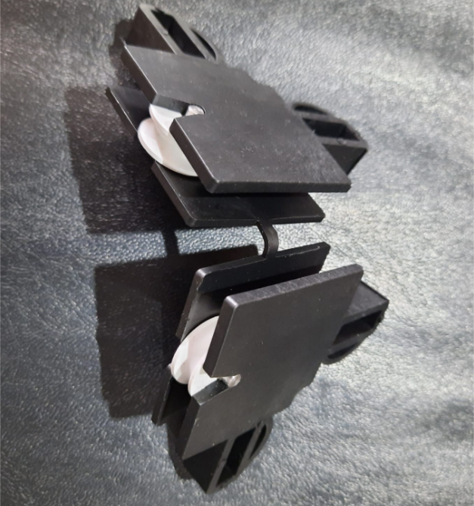
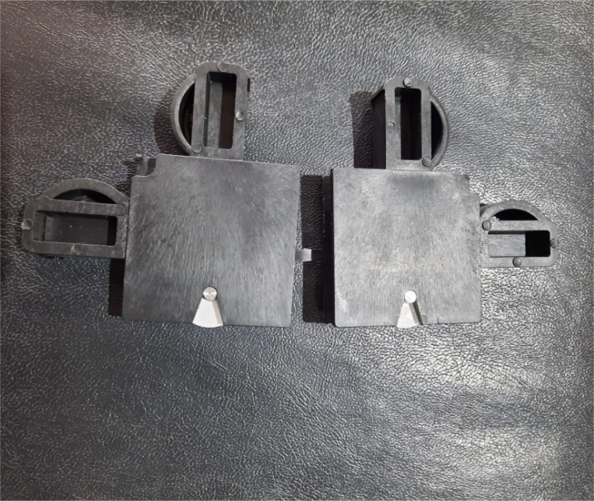
SLDING INSECT SCREEN CORNER WEDGE F-24
WITH WHEEL BLACK
- SLIDING SYSTEM
- INCLUDING WHEEL
- FOR 90° CUT PROFILE
- BLACK
- RAL 9005

Slide 13
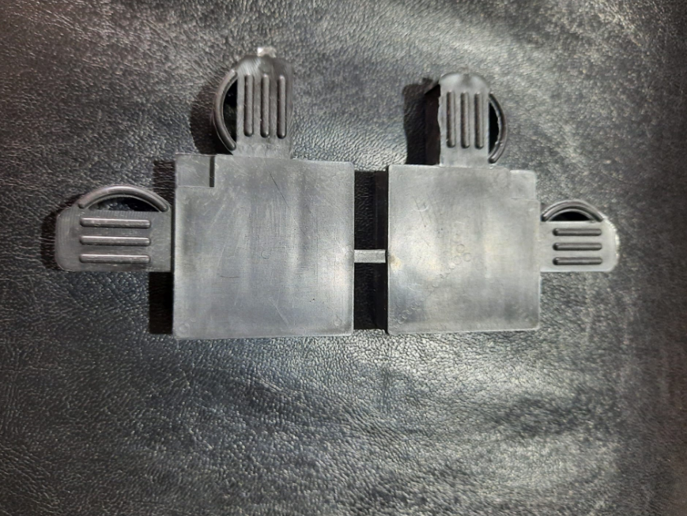
SLIDING INSECT SCREEN CORNER WEDGE F-25
BLACK
- SLIDING SYSTEM
- WITHOUT WHEEL
- FOR 90° CUT PROFILE
- BLACK
- RAL 9005

Slide 14
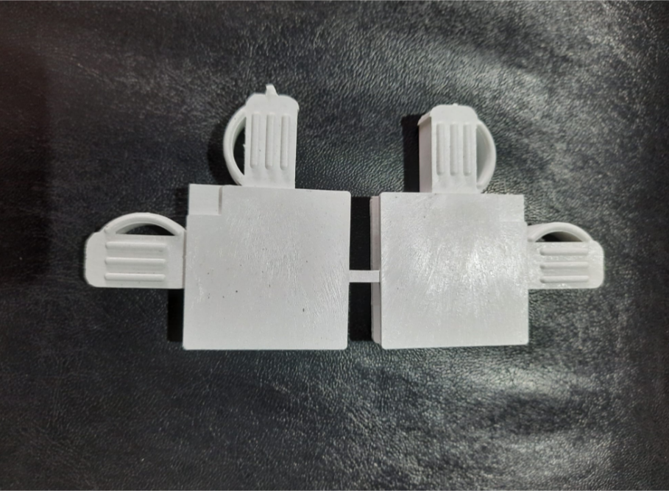
SLIDING INSECT SCREEN CORNER WEDGE F-25
WHITE
- SLIDING SYSTEM
- WITHOUT WHEEL
- FOR 90° CUT PROFILE
- WHITE
- RAL 9016

Slide 15
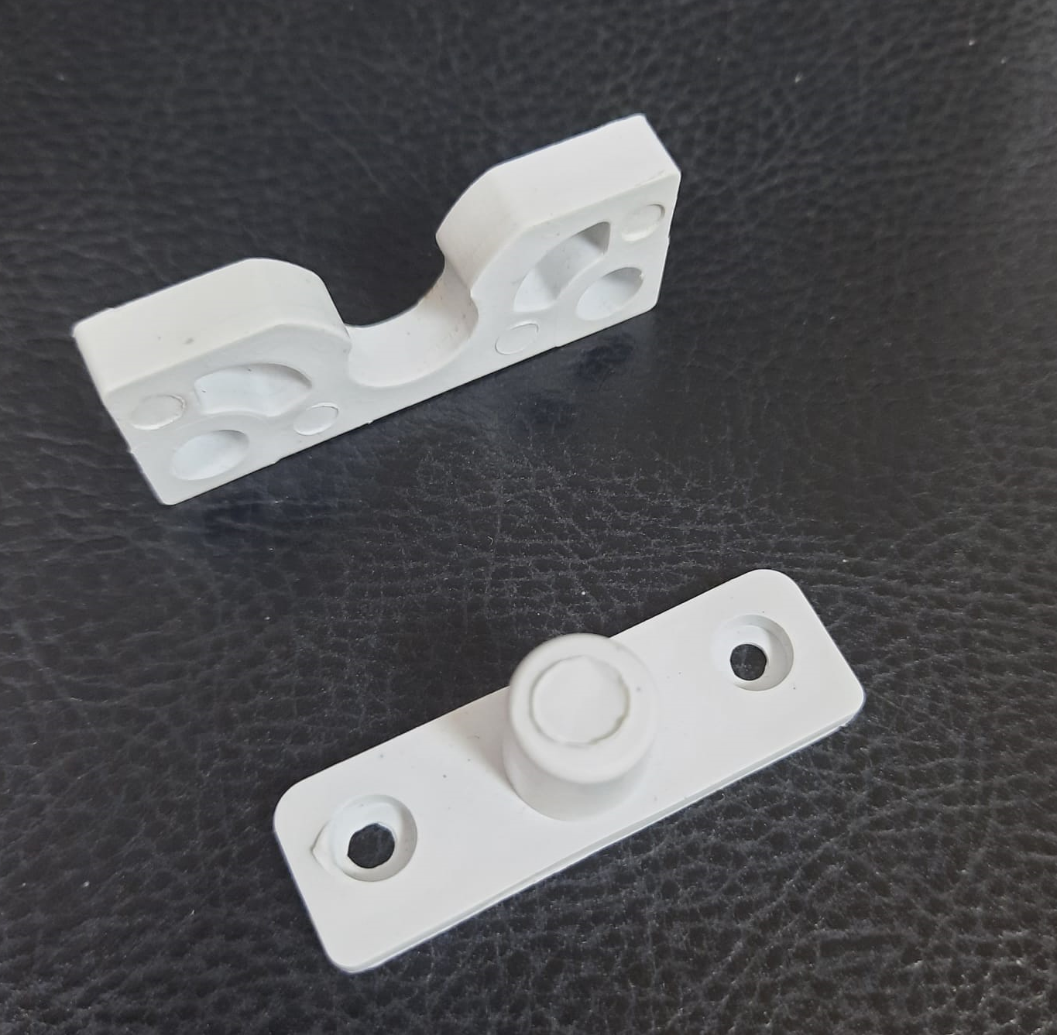
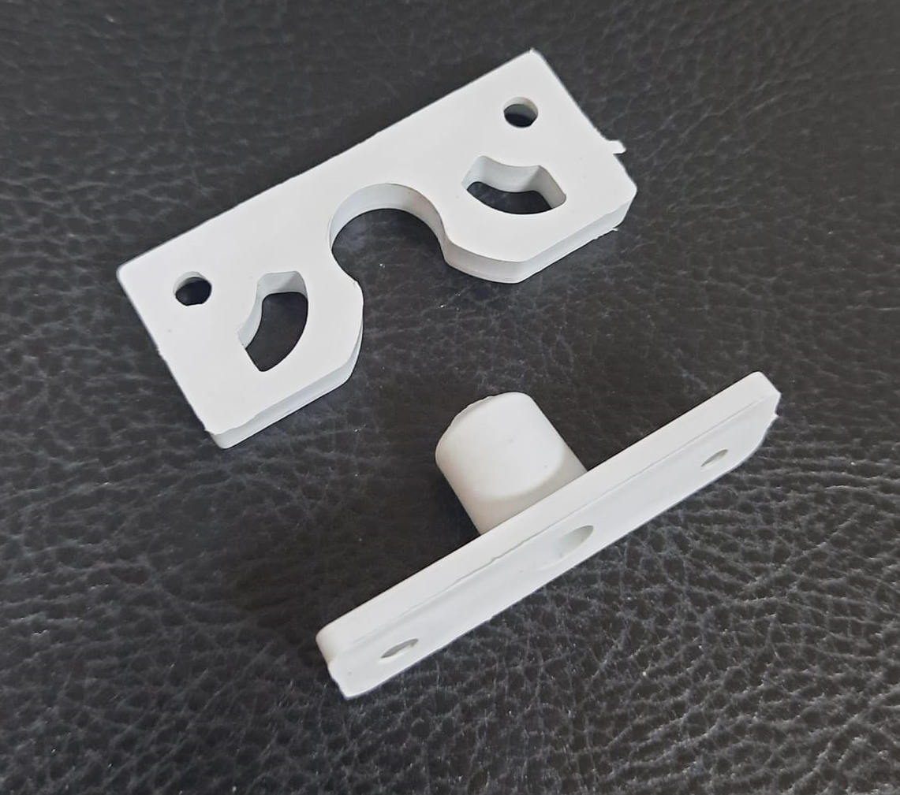
INSECT SCREEN GRIPPER WHITE F-35
GRIPPER FOR INWARD
OPENING SYSTEM
WHİTE
RAL 9016

Slide 16
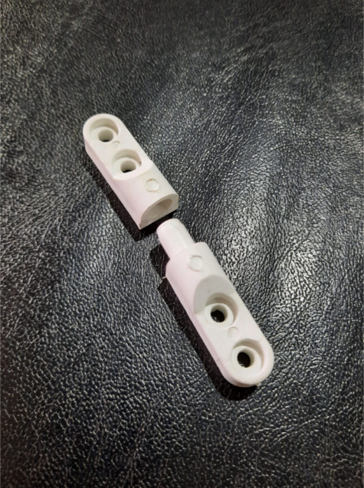
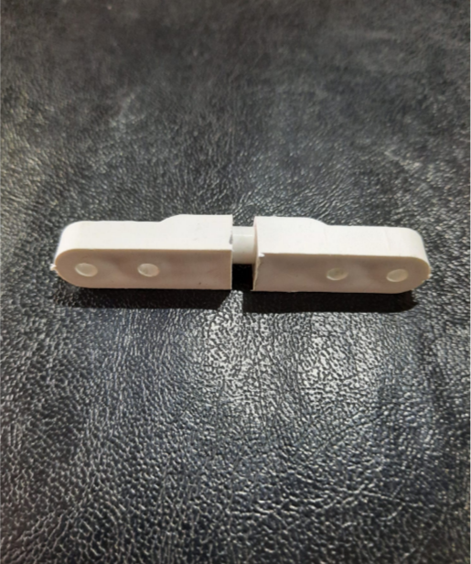
INSECT SCREEN HINGE F-36
INWARD OPENING WHITE
- HINGE 6.5 cm
- WHITE
- RAL 9016

Slide 17
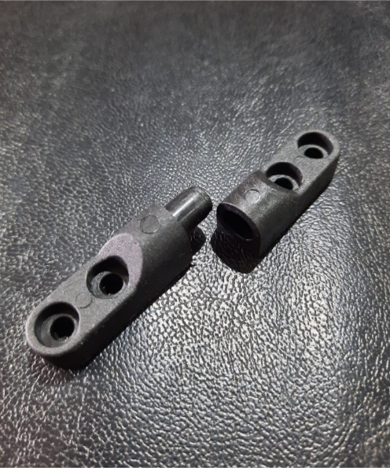
INSECT SCREEN HINGE F-36
INWARD OPENING BLACK
- HINGE 6.5 cm
- BLACK
- RAL 9005

Slide 18
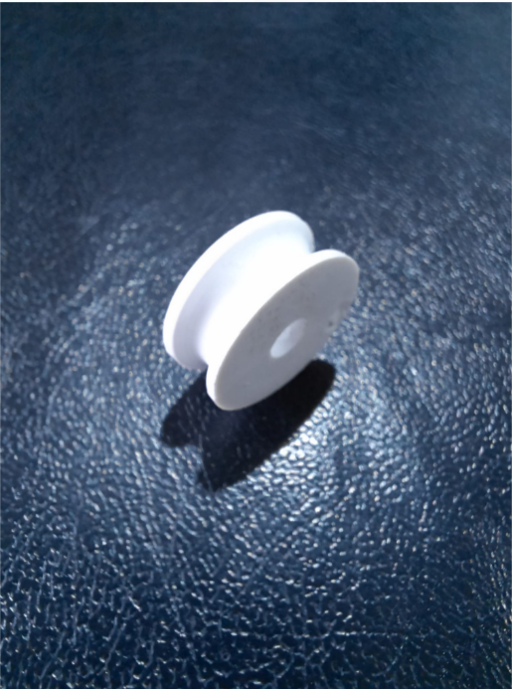
WHEEL
- SLIDING SYSTEM WHEEL
- WHITE
- RAL 9016

